Slide 1
Social Media Analytics

Slide 2
Introduction

Slide 3
Social Media Overview
Social media Data
Social media programmatic access
Data sources, services and tools
Data feeds via APIs
Text cleaning and storage tools
Text analysis tools
Transformation tools
Analysis tools
Social media platforms
Social network media platforms
News platforms

Slide 4
Social Media Data
Types of Data :
Historic data sets—previously accumulated and stored social/news, financial and economic data.
Real-time feeds—live data feeds from streamed social media, news services, financial exchanges, telecoms services, GPS devices and speech.
Raw data—unprocessed computer data straight from source that may contain errors or may be unanalyzed.
Cleaned data—correction or removal of erroneous (dirty) data caused by disparities, keying mistakes, missing bits, outliers, etc.
Value-added data—data that has been cleaned, analyzed, tagged and augmented with knowledge.

Slide 5
Social Media Providers
Social Media Data resources can be broadly divided into 3 categories.
Open Source Databases
Data Access via Tools
Data Access via APIs

Slide 6
Social Media Providers
Open Source Databases
A major open source of social media is Wikipedia,which offers free copies of all available content to interested users (Wikimedia Foundation 2014).
These databases can be used for mirroring, database queries and social media analytics.
Another example of freely available data for research is the World Bank data, World Bank Databank (http://databank.worldbank.org/data/databases.aspx)

Slide 7
Social Media Providers
Data Access via Tools
Freely accessible sources
Google with tools such as Trends and InSights is a good example of this category. Google is the largest ‘scraper’ in the world
Commercial sources
There is an increasing number of commercial services that scrape social networking media and then provide paid-for access via simple analytics tools. In addition, companies such as Twitter are both restricting free access to their data and licensing their data to commercial data resellers, such as Gnip and DataSift

Slide 8
Social Media Providers
Data feed access via APIs
Wiki media
Social networking media Twitter & Facebook
RSS feeds
Blogs, news groups and chat services
News feeds
Geospatial feeds

Slide 9
Text Cleaning, Tagging and Storing
The importance of ‘quality versus quantity’ of data in social media scraping and analytics cannot be overstated (i.e., garbage in and garbage out). In fact, many details of analytics models are defined by the types and quality of the data. The nature of the data will also influence the database and hardware used. Cleaning the data means removing the following .
Incorrect Data
Inconsistent Data
Missing Data

Slide 10
Text Cleaning, Tagging and Storing
Cleansing data
A traditional approach to text data cleaning is to ‘pull’ data into a spreadsheet or spreadsheet-like table and then reformat the text. For example, Google Refine3 is a standalone desktop application for data cleaning and transformation to various formats.
Tagging Unstructured Data
Since most of the social media data is generated by humans and therefore is unstructured (i.e., it lacks a pre-defined structure or data model), an algorithm is required to transform it into structured data to gain any insight. Therefore, unstructured data need to be preprocessed, tagged and then parsed in order to quantify/analyze the social media data. Adding extra information to the data (i.e., tagging the data) can be performed manually or via rules engines,which seek patterns or interpret the data using techniques such as data mining and text analytics.

Slide 11
Text Cleaning, Tagging and Storing
Storing data
The nature of the social media data is highly influential on the design of the database and possibly the supporting hardware. It would also be very important to note that each social platform has very specific (and narrow) rules around how their respective data can be stored and used.
For completeness, databases comprise:
Flat file
Relational database
noSQL databases

Slide 12
Text Cleaning, Tagging and Storing
Apache (noSQL) databases and tools
The research community is increasingly using Apache software for social media analytics.
Within the Apache Software Foundation, three levels of software are relevant:
Cassandra/hive databases
Hadoop platform
Mahout

Slide 13
Social Media Analytics Techniques
Natural language Processing, computational linguistics and text analytics are deployed to identify and extract subjective information from source text Computational Science Techniques
Automated sentiment analysis of digital texts uses elements from machine learning such as latent semantic analysis, support vector machines, bag-of-words model and semantic orientation. In simple terms, the techniques employ three broad areas:
Computational statistics
Machine learning
Complexity science
These techniques are deployed in two ways:
Data Mining
Simulation Modeling

Slide 14
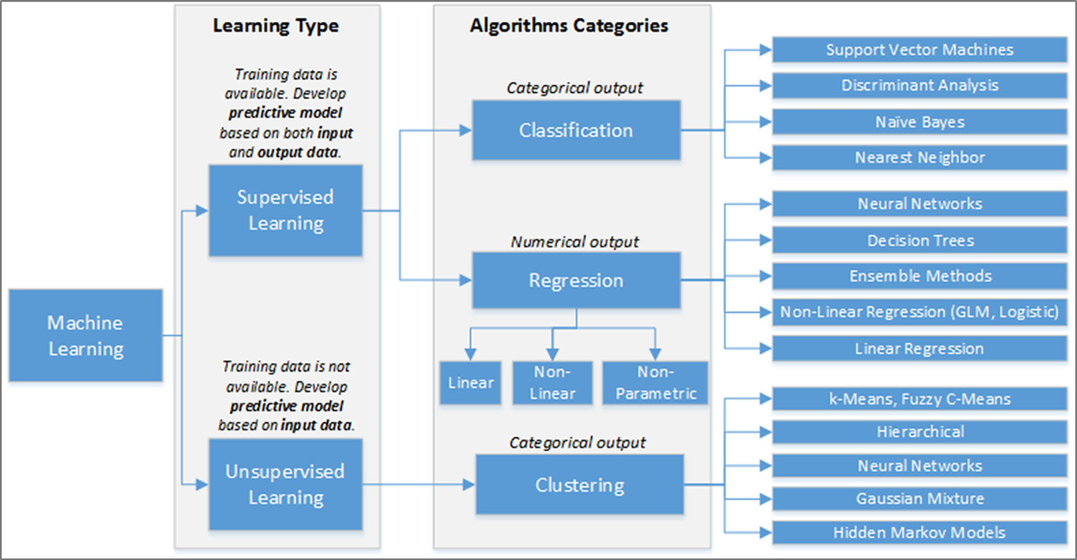
Machine Learning Overview

Slide 15
Social Media Analytics Techniques
Stream processing
Increasingly, analytics applications that consume real-time social media, financial ‘ticker’ and sensor networks data need to process high-volume temporal data with low latency. These applications require support for online analysis of rapidly changing data streams. However, traditional database management systems (DBMSs) have no predefined notion of time and cannot handle data online in near real time. This has led to the development of Data Stream Management Systems (DSMSs)
processing in main memory without storing the data on disk that handle transient data streams on-line and process continuous queries on these data streams. Example commercial systems include: Oracle CEP engine, StreamBase and Microsoft’s StreamInsight

Slide 16
Social Media Analytics Techniques
Sentiment Analysis
Sentiment is about mining attitudes, emotions, feelings—it is subjective impressions rather than facts.
Sentiment classification
Sentiment analysis divides into specific subtasks:
Sentiment context
Sentiment level
Sentiment subjectivity
Sentiment orientation/polarity
Sentiment strength

Slide 17
Social Media Analytics Tools
Scientific Programming Tools
Business Toolkits
Social Media Monitoring Tools
Text Analysis Tools
Data Visualization Tools

Slide 18
Social Media Analytics Tools
Scientific Programming Tools
R—used for statistical programming
MATLAB—used for numeric scientific programming
Mathematica—used for symbolic scientific programming (computer algebra)
Python
ApacheUIMA (Unstructured Information Management Applications).

Slide 19
Social Media Analytics Tools
Business Toolkits
SAS Sentiment Analysis Manager can be used for :
Scraping Content Sources
Creating reports
RapidMiner a popular toolkit offering an open-source Community Edition and also an Enterprise Edition offered under a commercial license.
RapidMiner provides Data Mining and Machine Learning procedures including:
Data Loading and Transformation
Data Preprocessing and Visualization
Modeling, Evaluation, and Deployment.

Slide 20
Social Media Analytics Tools
Social Media Monitoring Tools
Social media monitoring tools are sentiment analysis tools for tracking and measuring what people are saying (typically) about a company or its products, or any topic across the web’s social media landscape.
In the area of social media monitoring examples include
Social Mention, (http://socialmention.com/)
Amplified Analytics (http://www.amplifiedanalytics.com/)
Lithium Social Media Monitoring
Trackur
Google also provides a few useful free tools.
Google Trends
Google Alerts
Google also acquired FeedBurner ,an RSS feeds management in 2007

Slide 21
Social Media Analytics Tools
Text Analysis Tools
OpenAmplify
Jodange
Stanford NLP group tools
LingPipe
Python NLTK
Lexalytics Sentiment Toolkit
Aero Text
Attensity
Clarabridge, IBM Language Ware, SPSS Text Analytics for Surveys
Language Computer Corporation
STATISTICA Text Miner and WordStat.

Slide 22
Social Media Analytics Tools
Data Visualization Tools
The data visualization tools provide business intelligence(BI) capabilities and allow different types of users to gain insights from the Big Data.
Two notable visualization tools are
SAS Visual Analytics
Tableau.
Python Library for Data Visualization
Matplotlib
Seborn

Slide 23
Thanks!
Any questions?

